Slide 1

Life’s Simple 7
RHP9&10 Learning Collaborative
February 9, 2016
Eduardo Sanchez, MD,MPH,FAAFP
Chief Medical Officer for Prevention
American Heart Association

Slide 2
2012 Leading Causes of o
Death in the Texas
Diseases of the Heart
Malignant Neoplasms (Cancer)
Chronic Lower Respiratory Diseases
Cerebrovascular Disease (Stroke)
Accidents (Injuries)
Alzheimer's Disease
Diabetes Mellitus
Septicemia (Blood Poisoning)
Nephritis, Nephrotic Syndrome, Nephrosis
Influenza and Pneumonia
The Health Status of Texas 2014

Slide 3

Burden of disease attributable to leading risk factors, 2013
Dietary risks
High body mass index
Tobacco smoke
High blood pressure
Alcohol and drug use
High fasting plasma glucose
High total cholesterol
Low physical inactivity
Low glomerular filtration rate
Occupational Risks
http://www.healthdata.org/united-states
Notes:
At the same time, changing the conversations and capabilities of individuals and families to build and expect their own cultures of health is essential .
Let’s see how that is already playing out within our existing and planned strategies.
.

Slide 4
Rates of premature death in United States versus comparison locations, 2013
Ischemic heart disease Higher
Lung cancer Higher
Road injuries Higher
Self-harm Same
COPD Higher
Cerebrovascular disease Lower
Alzheimer disease Higher
Drug use disorders Higher
Diabetes Higher
Congenital anomalies Higher
http://www.healthdata.org/united-states
Notes:
At the same time, changing the conversations and capabilities of individuals and families to build and expect their own cultures of health is essential .
Let’s see how that is already playing out within our existing and planned strategies.
.

Slide 5
Multiple Chronic Conditions (MCC)
One in four (25%) Americans has multiple chronic conditions(MCC), including one in 15 children
Among Americans aged 65 years and older, as many as three out of four persons (75%) have MCC.
People with MCC are at increased risk for mortality and poorer day-to-day functioning.
Approximately 66 percent (66%) of total health care spending in the U.S. is associated with care for Americans with MCC.
HHS Initiative on Multiple Chronic Conditions, hhs.gov

Slide 6


American Heart Association 2020 Impact Goal
“By 2020, to improve the cardiovascular health of all Americans by 20% while reducing deaths from cardiovascular diseases and stroke by 20%.”
20%
2020

Slide 7
Ideal Cardiovascular Health:
Life’s Simple 7
Smoking Status
Physical Activity
Healthy Diet
Healthy Weight
Blood Pressure
Cholesterol
Blood Glucose

Slide 8






A Framework for Producing Health
Cardiovascular Health Definitions
LIFE’S SIMPLE 7 |  | POOR | INTERMEDIATE | IDEAL
 | Smoking Status Adults >20 years of age Children (12–19) | Current Smoker Tried prior 30 days | Former ≤ 12 mos | Never /quit ≥ 12 mos
 | Physical Activity Adults > 20 years of age Children 12-19 years of age | None None | 1-149 min/wk mod or 1-74 min/wk vig or 1-149 min/wk mod + vig >0 and <60 min of mod or vig every day | 150+ min/wk mod or 75+ min/wk vig or 150+ min/wk mod + vig 60+ min of mod or vig every day
 | Healthy Diet Adults >20 years of age Children 5-19 years of age | 0-1 components 0-1 components | 2-3 components 2-3 components | 4-5 components 4-5 components
 | Healthy Weight Adults > 20 years of age Children 2-19 years of age | ≥30 kg/m² >95th percentile | 25-29.9 kg/m2 85th-95th percentile | <25 kg/m² <85th percentile
 | Blood Glucose Adults >20 years of age Children 12-19 years of age | 126 mg/dL or more 126 mg/dL or more | 100-125 mg/dL or treated to goal 100-125 mg/dL | Less than 100 mg/dL Less than 100 mg/dL
 | Cholesterol Adults >20 years of age Children 6-19 years of age | ≥240 mg/dL ≥200 mg/dL | 200-239 mg/dL or treated to goal 170-199 mg/dL | <170 mg/dL
 | Blood Pressure Adults >20 years of age Children 8-19 years of age | SBP ≥140 or DBP ≥90 mm Hg >95th percentile | SBP120-139 or DBP 80-89 mm Hg or treated to goal 90th-95th percentile or SBP ≥120 or DBP ≥80 mm Hg | <120/<80 mm Hg <90th percentile
Notes:
THIS ONE>>>>>>>
The chart illustrates the detailed measures for the seven health factors and health behaviors at poor, intermediate and ideal cardiovascular health. You may note we have specific measures for adults, as well as children. Children are weighted according to the percentage of the overall population – approximately 25%.
There are three health factors: blood pressure, cholesterol, blood glucose; and four health behaviors: physical activity, healthy diet, smoking, healthy weight.
The goal is to reduce prevalence of poor CV health and increase prevalence of ideal CV health for a cumulative improvement of 20%.
As a reminder, our 20% improvement is based on the overall weighted average out “poor” and into “ideal”.

Slide 9
Why
focus on Simple 7?
Number of Ideal Heart Health Behaviors
or Factors and Mortality
Deaths per 1000 person-years
Yang, et al, JAMA, Vol 307, No.12, March 28, 2012
Notes:
But changing a culture and moving millions of people into better levels of health is complicated, requiring the right approaches, new knowledge, time and resources. In order to best accomplish this, we use a socio-ecological model that acknowledge many levels of change must occur and complement one another. Federal policies and national changes in practice can impact everyone’s health. State level changes support national changes and meet the needs of their region. At the community level, the actual impact on daily lives is felt in our schools, workplaces, neighborhoods.
At the same time, changing the conversations and capabilities of individuals and families to build and expect their own cultures of health is essential .
Let’s see how that is already playing out within our existing and planned strategies.
.

Slide 10
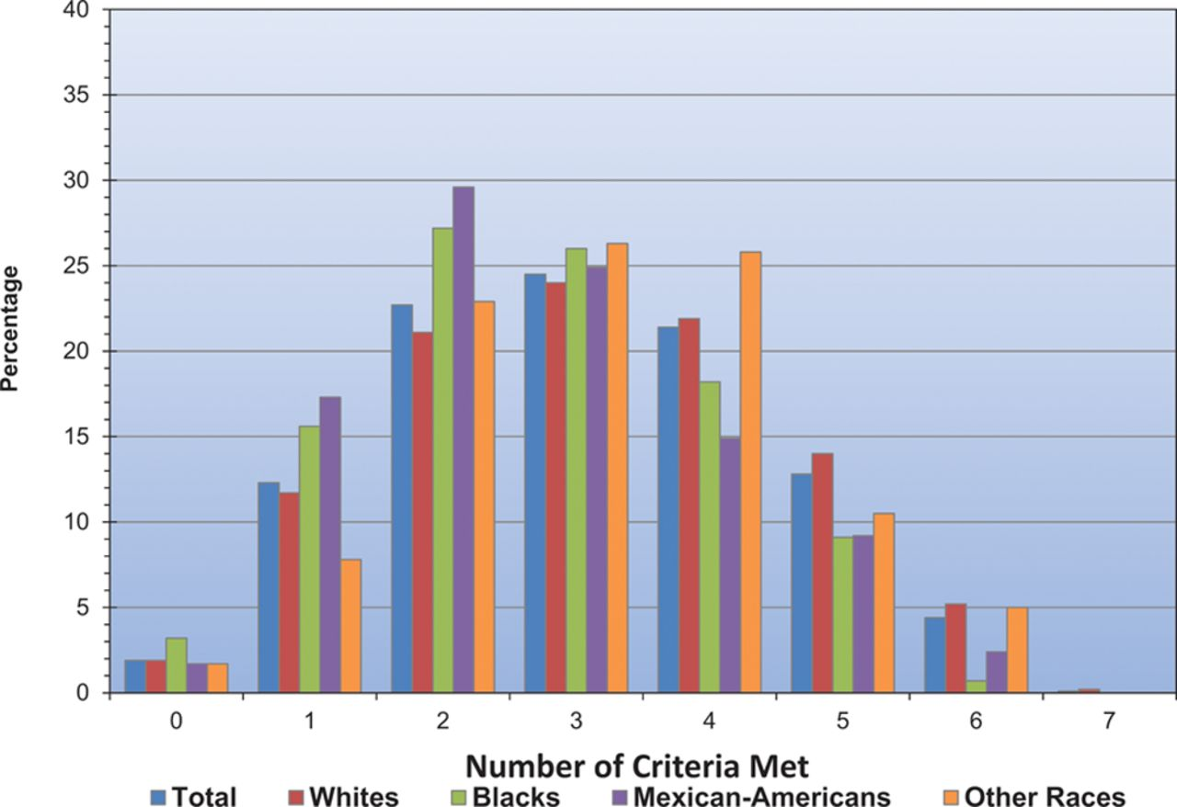

Age-standardized prevalence estimates of US adults aged ≥20 years meeting different numbers of criteria for ideal cardiovascular health, overall and in selected race subgroups from National Health and Nutrition Examination Survey 2009 to 2010.
Go A S et al. Circulation. 2014;129:e28-e292
Copyright © American Heart Association, Inc. All rights reserved.
Notes:
Age-standardized prevalence estimates of US adults aged ≥20 years meeting different numbers of criteria for ideal cardiovascular health, overall and in selected race subgroups from National Health and Nutrition Examination Survey 2009 to 2010.

Slide 11



Simple 7 Prevalence in Adults: Dallas, TX
Percent of Adults with Inadequate Fruit / Veggie Consumption
Percent of Adults with <150 min of MVPA / Week
Percent Adults with High Cholesterol
Percent Adults with BMI > 30.0 (Obese)
Percent Adults told to have High Blood Pressure
Percent Adults Smoking Cigarettes
Percent Adults with Diagnosed Diabetes
BRFSS 2011-2012
MVPA – moderate to vigorous physical activity
Notes:
The greatest areas of need are in healthy diet and physical activity. Together, these have led to the startling increase in childhood obesity, with more than one in three kids overweight or obese. In turn, this has led to the health factors we see on the right: high cholesterol, high blood pressure and high fasting glucose levels. Nearly all children are born in ideal CV health and yet so few are able to maintain it.
Note: New healthy diet score information is not available.

Slide 12
Health of Texas
RHP 9
Dallas
Denton
Kaufman
RHP 10
Ellis
Erath
Hood
Johnson
Navarro
Parker
Somervell
Tarrant
Wise

Slide 13
Texas Public Health Challenges (2005)
Exploding costs
Highest rate of uninsured
Rapid population growth
Low immunization rates
Threat of bioterrorism
An epidemic of obesity
Challenges of border region
Sharp health disparities
Mental health challenges
Substance abuse challenges

Slide 14
It’s like déjà vu all over again.
-Yogi Berra

Slide 15
Texas Public Health Challenges (2016)
Exploding costs
Highest rate of uninsured
Rapid population growth
Better Low immunization rates
Threat of bioterrorism emerging infectious diseases and other public health challenges
An epidemic of obesity
Challenges of border region
Persistent health disparities
Mental health challenges
Substance abuse challenges

Slide 16
National Healthcare Quality and Disparities Report 2014
Texas is a weak performer in its balance of below average, average, and above average measures compared to all states. (continuum – very weak, weak, average, strong, very strong)
  Texas is 3rd from last.
  Healthy living – weak
  Diabetes – very week
  Prevention – weak
  Chronic – at intersection of very weak and weak
Ahrq.gov

Slide 17
National Healthcare Quality and Disparities Report 2014
Texas
Strongest measures
  3 of 5 related to vaccinations in 13 to 17 year olds
Weakest measures
  ESRD due to diabetes per 1,000,000
  Lower extremity amputations due to diabetes per 1000
  Admissions for uncontrolled diabetes without complications per 100,000
  Avoidable admissions for high blood pressure per 100,000
  New AIDS cases per 100,000
Ahrq.gov

Slide 18
Code Red 2015 Recommendations
• Obtain a greater share of federal tax funding to expand health insurance coverage so more Texans have access to primary care
• Extend/renew the current Medicaid 1115 Waiver.
• Create an appropriate state health plan, such as Texas Prescription TxRx
• Develop robust local and regional health care delivery systems with increasing emphasis on wellness and prevention programs.
• Continue to expand behavioral health care and integrate with primary care.
• Expand the health care workforce in response to community need.
• Support continued federal funding of FQHCs.
Code Red Task Force on Access to Health Care in Texas; http://www.coderedtexas.org/files/2015-code-red-report.pdf

Slide 19
Underinvestment in Public Health
3%
“Prevention requires tools that are often unfamiliar because educational, behavioral, and social interventions, not usually considered to be part of medicine, may be most effective for many diseases.” – Moses et. al. (JAMA, 2013)
Of real national health care expenditures since 1980s
Moses et al. The anatomy of health care in the United States. JAMA. 2013

Slide 20
Public Health Spending Linked to Declines in Preventable Deaths
Mortality rate | % decrease per 10% spending increase
Infant deaths per 1000 live births | 6.85
Heart disease deaths per 100,000 | 3.22
Diabetes deaths per 100,000 | 1.44
Cancer deaths per 100,000 | 1.13
Influenza deaths per 100,000 | 0.25
Mays and Smith, Health Affairs. Aug 2011;30(8).
Notes:
20

Slide 21
1115 Waiver in Texas
Social Security grants HHS Secretary the authority to approve projects aimed at furthering the objectives of Medicaid.
Texas’ five-year Waiver through September 2016.
Two funding pools
  Uncompensated care – to hospitals - $17.6 billion
  Delivery System Reform Incentive Program – regional health system reform to achieve the triple aim – $11.4 billion
$12 billion local dollars that serves as leverage to draw down $17 billion federal dollars
Deadline for extension request – September 30, 2015
Texas Family Physician, Vol. 66 No. 3 2015

Slide 22
Delivery System Reform Incentive Program (DSRIP)
25% behavioral health
20% access to primary care
18% chronic care management and health system navigation
Texas Family Physician, Vol. 66 No. 3 2015

Slide 23
Prevalence of psychiatric disorders in low-income primary care patients
Psychiatric disorder | General Primary care population | Low-income patients
At least one psychiatric disorder | 28% | 51%
Mood disorder | 16% | 33%
Anxiety disorder | 11% | 36%
Alcohol abuse | 7% | 17%
Eating disorder | 7% | 10%
Mauksch, L. B., et al. (2001). Journal of Family Practice, 50(1), 41-47.

Slide 24
Delivery System Reform Incentive Program (DSRIP)
Report by Texas Academy of Family Physicians and Texas Association of Community Health Centers concludes that…Texas leaders must adopt and execute a plan for the 115 waiver renewal that includes drawing down all available federal funds to expand health coverage for low-income Texans.
Texas Family Physician, Vol. 66 No. 3 2015

Slide 25
Some numbers
27,000,000 (27 million) Texans
Estimating 5,000,000 uninsured
$29 Billion over 5 years = $5.8 B per year
Then the waiver represents a spend of $1160 per uninsured Texan per year over 5 years
U.S. health care spending reached $9,255 per person in 2013.
dshs.state.tx.us

Slide 26
More numbers
$ 3.3 billion annual budget for DSHS
27,000,000 (27 million) Texans
Then the state spends $122.22 per Texan per year through DSHS
8% of DSHS funding identified as spending for public health = $9.78 per Texan per year
dshs.state.tx.us

Slide 27











Building a Healthy Community
Tobacco
Increase percentage of Americans who live in environments that support smoke-free air and smoking cessation
Nutrition
Improve environments that support healthy eating and improve quality of foods available
Physical Activity
Increase percentage of Americans who live in environments that support active lifestyles
Health Factors
Improve environments that support healthy weight, blood pressure, glucose and cholesterol
CPR/Chain of Survival
Increase percentage of Americans who live in environments that support emergency response for cardiac arrest
Acute Care &
Emergency Response
Increase percentage of Americans who live in environments that support decreased cardiovascular disease mortality and improved quality of life
Post-Event Care
Increase percentage of Americans who receive the support and education needed after acute events
Social Determinants
Ensure safe places to work, play, and get care are available for all Americans

Slide 28
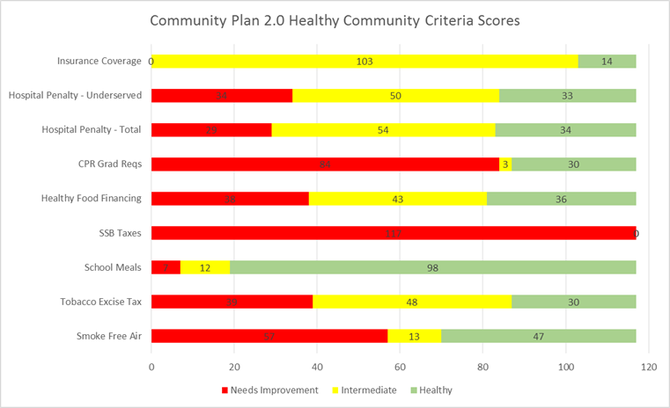

Slide 29

Example: Tobacco
 | Outcome | Good | Intermediate | Poor
Reduce Tobacco | Increase percentage of Americans who live in environments that support smoke-free air and smoking cessation. | 100% of community covered by clean indoor air legislation in all restaurants/ bars/ workplaces | 100% of community covered by clean indoor air legislation in all restaurants/bars | Community covered by clean indoor air legislation below intermediate level
 |  | Excise tax=$1.85 or > per pack | Excise tax=$1 or > per pack | Excise tax= <$1 per pack
 |  | Access to smoking cessation and prevention campaign | Access to smoking cessation and prevention campaign | Access to smoking cessation and prevention campaign

Slide 30
Relationship Between Social Determinants and Mortality (2000)
Galea et al, Estimated Deaths Attributable to Social Factors in the United States ,
AJPH, August 2011, Vol 101, No. 8.

Slide 31

Bridging Community and Clinical Care

Slide 32
Framework for Integrated Clinical and Community Systems of Care
Equity
Training & Education
Family & Individual Empowerment and Engagement
Care Delivery
Information Systems
Decision Support
Delivery System Design
Self Management Support
Local Patient Environment
Clinicians
Community
Systems
Resources
Services
Supportive
Environment
Social Norms
Integration
Convener, Advocacy, Data Exchange, Financing, Governance/Regulation, Referral Processes, Communication
Metrics
Health Aff Sept 2015
vol. 34 no. 9 1456-1463
Population Health

Slide 33
Public Health and Medical Care
Primary Care and Public Health: Exploring Integration to Improve Population Health
A broad definition of integration: the linkage of programs and activities to promote efficiency and effectiveness and achieve gains in population health.
Integration of primary care and public health could enhance the capacity of each to carry out their missions and link with other stakeholders to produce health
IOM (Institute of Medicine). 2012. Primary Care and Public Health: Exploring
Integration to Improve Population Health. Washington, DC: The National Academies Press.

Slide 34
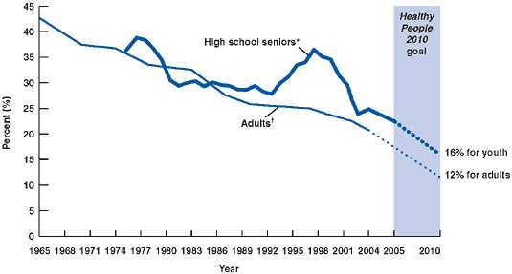
US Smoking Trends—High School Seniors and Adults (1965–2004)
DSHS
Notes:
Tobacco use is the leading cause of preventable death, disease and excess health care costs
* High school seniors who smoked 1 or more cigarettes during the previous 30 days (Institute for Social Research, University of Michigan. Monitoring the Future Project, 1975–2004).
†Total population of adults who are current cigarette smokers (National Health Interview Surveys, 1965–2003).

Slide 35
Diabetes Prevention Program (DPP)
 | Placebo | Metformin | Lifestyle
Incidence of diabetes (percent per year) | 11.0% | 7.8% | 4.8%
Reduction in incidence compared with placebo | – | 31% | 58%
Number needed to treat to prevent 1 case in 3 years | – | 13.9 | 6.9
The DPP Research Group, NEJM 346:393-403, 2002
35
Notes:
35

Slide 36


Motivating Millions to Lower Blood Pressure
Notes:
Lisa to open the call

Slide 37
Blood Pressure Control Evades Us
One in three American adults — about 80 million people — have high blood pressure
High blood pressure contributes to heart attack and heart failure, stroke, kidney failure, and other deadly consequences
New data supports recommendations for keeping blood pressure low
Notes:
Eduardo
One in three American adults have high blood pressure. This is about 80 million people. Additionally only 54% of these people have their BP controlled even though we have had effective treatments for 50 years. To achieve our 2020 goal we are going to need to move 13.6 M of these people to control. High blood pressure is often noted as a contributing risk factor to heart attack and heart failure, stroke, kidney failure, and other deadly consequences and a recent new study supports keeping our blood pressure low.

Slide 38
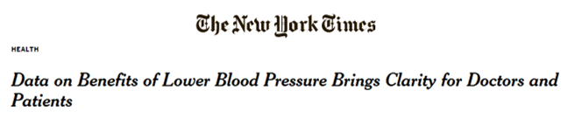
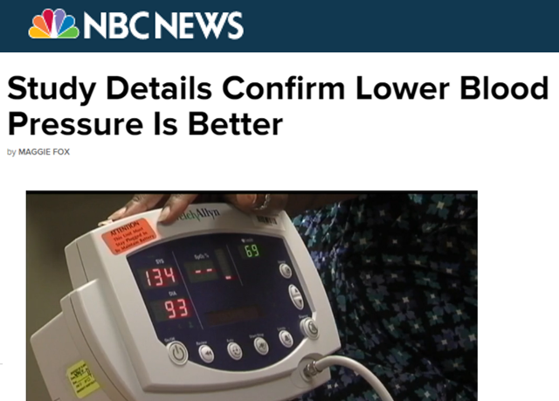
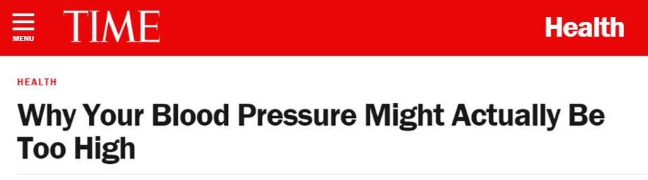
SPRINT: An Opportunity to Elevate the Message
Data from the Systolic Blood Pressure Intervention Trial (SPRINT) supports lowering blood pressure and generated significant attention at AHA Scientific Sessions
Target: BP launched at Sessions on November 9 to leverage the momentum of SPRINT and draw attention to how we can fight high blood pressure
Notes:
Eduardo
Just prior to sessions the National Institutes of Health (NIH) reported on the results of the SPRINT Trial, for people age 50 and older with high blood pressure and at least one other risk factor for heart disease, they noted lowering blood pressure to under 120 mm Hg reduced a combined end point of heart attack, acute coronary syndrome, heart failure and strokes by 30% more than lowering it to 140 mm Hg. In addition, deaths from any cause were reduced by 25% in those treated to reach a goal of 120 mm Hg. The study's independent data safety and monitoring board called for the study to be halted because of this significant benefit, which clearly outweighed any harm.
This study was promoted during Sessions and we used the momentum of the SPRINT Trial to draw attention to our new initiative: Target: BP.

Slide 39






What is Target: BP?
A call to action motivating hospitals, medical practices, practitioners and health services organizations to prioritize blood pressure control
A source for tools and assets for healthcare providers to use in practice, including the AHA/ACC/CDC Hypertension Treatment Algorithm
Recognition for healthcare providers who attain high levels of blood pressure control in their patient populations, particularly those who achieve 70, 80 or 90 percent control
Notes:
Sara
Target: BP is a call to action motivating hospitals, medical practices, practitioners and health services organizations to prioritize blood pressure control. We are asking healthcare providers across the country to join us and work within their systems to increase their control rates for HBP patients to 70% or better.
We will provide tools and assets for healthcare providers to use in practice, including the AHA/ACC/CDC Hypertension Treatment Algorithm through Target: BP. There is a dedicated website to register for Target: BP and access resources for providers and patients: www.heart.org/targetbp
We will then recognize healthcare providers who attain high levels of blood pressure control in their patient populations, particularly those who achieve 70, 80 or 90 percent control. The first recognition will take place during Sessions 2016.
We have reached out to the AMA and Million Hearts and they our in support of the program.

Slide 40
Tackling High Blood Pressure
Improve blood pressure control in traditional and non-traditional settings.
Increase HBP control in clinical settings through the adoption of HBP treatment algorithm.
Increase HBP control in non-traditional settings through community-based partnerships.
Linking Clinical and Community Settings
Notes:
Diving deeper into the strategy supporting our health impact goal we have focused our efforts on increasing blood pressure control in both traditional – clinical – and non-traditional – community-based – settings.
While these strategies look differently when deployed in their respective settings – for example in the clinical setting we are working through The Guideline Advantage platform to help clinicians adopt proven treatment algorithms that drive system-wide bp control, while in community settings we are seeking partnerships with a variety of organizations – senior living centers and YMCAs for example – to support individuals in the practice of self-management and lifestyle change.
That said, we believe our efforts in clinical and community settings are strongest when linked, which is where this new funding from Kaiser will help us go.

Slide 41






Improving Hypertension Control Particularly in Blacks and African Americans
Community to Clinic, Clinic to Community (C2C2)
COMBINING UNIQUE ASSETS
Bringing together strategic AHA assets directed toward
a key national and local issue.
Science (evidence-based guidelines)
Life’s Simple 7 (evidence-based health measures)
Check.Change.Control. (community HBP program)
Heart360 (online personal health tracking tool)
Empowered To Serve (faith-based mega community)
The Guideline Advantage (HCP quality improvement)
Communications (infrastructure & media partnerships)
INTEGRATED APPROACH
Leadership, shared tools, protocols, resources and training to deliver improved care, resulting in new, reciprocal connectivity and targeted support between the patient, the clinic, and the community.
INNOVATION
Transformative care delivery mechanism
Lean management principles to iterate the model
Surround-sound communication campaign
Registry to connect the community and clinical settings
Learning Collaborative
TRUSTED PARTNERS
ALGORITHM
MEDICAL
ASSISTANT
SELF
TRACKING
SHARED
METRICS
REGISTRY
2
Community
Clinical
1
ATLANTA
HEALTH MENTORS
TEACH
LIFESTYLE
SKILLS
MEDS
CITIES
3
2
SAN DIEGO
SELF
MONITOR
AD COUNCIL
CONSULT
SERVICES
YEARS
The AHA and Kaiser Permanente have a unique opportunity to co-create a scalable, groundbreaking model which establishes and maximizes clinical care and community stakeholder assets, competencies, and partnerships.
Notes:
We have recently received funding from the Kaiser Permanente Community Benefit Foundation to further expand our efforts to study new approaches to improving high blood pressure control, in this case in harder to control populations with an emphasis on African Americans, and in doing so – take that next step to connect clinical and community settings in the effort.
With this initiative, we will be able to combine –
Our the work of Check. Change. Control. in the community
With The Guideline Advantage program working in outpatient settings to improve quality
And the community-based channels our multicultural market team is opening through EmPowered to Serve
With the great reach and awareness building our Ad Council campaign allows for
Our funding will cover three years, with year 1 largely being used for planning and we will be able to pilot the model in two very different communities – Atlanta and San Diego.

Slide 42
The Role of Health Care in Population Health
Barriers that must be overcome for health system-based efforts to contribute to optimized population health
Misaligned stakeholder interests and population health investments
Inadequate information transfer
Inadequate service integration between health care and other sectors
Designing and functioning within a sustainable budget
Difficulties addressing health disparities
Eggleston & Finkelstein. JAMA 2014;311(8); 2/26/14
Notes:
42

Slide 43
Challenges Associated with Establishing and Maintaining Population Health Initiatives
Public health benefits are dispersed and delayed, and success is when “nothing happens”
Public health practitioners are not celebrities – not since C Everett Koop
Public health programs are taken for granted (think indoor plumbing, water quality, food safety)
Approaches that may involve regulation or fees or taxes can generate fierce opposition
Public health sometimes clashes with moral values (think HPV, needle exchange, family planning)
Population health improvement requires actions and resources outside of public health [and medical care]
Mayes and Oliver, Journal of Health Politics, Policy and Law, Vol. 37, No. 2, April 2012
Notes:
43

Slide 44
Accountable Care as a Strategy for Achieving Population Health Goals
To meet the responsibility to improve health outcomes for those under their care and society at large, health systems will need to:
Take responsibility for the health of their patient populations [and their communities]
Create and expand partnerships with other entities with the potential to influence health
Respond to social demands for equity and value
Eggleston & Finkelstein. JAMA 2014;311(8); 2/26/14
Notes:
44

Slide 45
Accountable Health Organizations (AHOs)
Manages the health investment portfolio for a community
“Health in All Policies” to produce health
All services - retail, government, other private (the business sector), social, health (including public health, medical, dental, mental health care) services associated with a defined population – that should be held accountable for the health status and outcomes for that population.
Attribution methodologies for accountability (credit for contribution to health for allocation of resources and charges to fund and sustain the system).
A system whose performance is measured by progress towards achieving highest health status (= economic competitiveness)
Notes:
The “providers” of services will include housing, retail, schools, local health departments, health plans, employers, primary care providers, specialists, and other health and non-health professionals who share responsibility for the quality and cost of goods and services provided to individuals and communities and for maximizing individual and community health.

Slide 46
Accountable Health Communities (AHC)
Announced January 5, 2016
The Accountable Health Communities (AHC) model addresses a critical gap between clinical care and community services in the current health care delivery system by testing whether systematically identifying and addressing the health-related social needs of beneficiaries’ impacts total health care costs, improves health, and quality of care. In taking this approach, the Accountable Health Communities model supports the Center for Medicare & Medicaid Service’s (CMS) “better care, smarter spending, and healthier people” approach to improving health care delivery.
CMS will award a total of 44 cooperative agreements ranging from $1 million (per Track 1 site) to $4.5 million (per Track 3 site) to successful applicants .
The Model aims to identify and address beneficiaries’ health-related social needs in at least the following core areas:
  Housing instability and quality;
  Food insecurity;
  Utility needs;
  Interpersonal violence; and
  Transportation needs.
http://www.hhs.gov/about/news/2016/01/05/
first-ever-cms-innovation-center-pilot-project-test-improving-patients-health.html

Slide 47
Accountable Community for Health (ACH)
… a collaborative of the major health care systems, providers, and health plans, along with public health, key community and social services organizations, schools and other partners serving a particular geographic that is responsible for improving the health of the entire community, with particular attention to reducing health disparities. The goals of an ACH are to:
improve community-wide health outcomes and reduce disparities with regard to particular chronic diseases;
reduce costs; and,
through a Wellness Fund, develop financing mechanisms to sustain the ACH and provide ongoing investments in prevention and other system-wide efforts to improve population health.
http://www.chhs.ca.gov/PRI/CalSIM%20Accountable%
20Communities%20for%20Health%20Webinar%20slides.pdf3/6/14

Slide 48
Accountable Community for Health (ACH)
Portfolio of interventions
Policy and systems
Environments
Community resource and social services
Community-Clinical Linkages
Clinical Services
http://www.chhs.ca.gov/PRI/CalSIM%20Accountable%
20Communities%20for%20Health%20Webinar%20slides.pdf3/6/14

Slide 49
Source of funds: Hospital Community Benefit Programs to Increase Benefits to Communities
Principles to guide the development of a strategy for leveraging community benefit
Define mutually agreed-on regional geographic boundaries to align both community benefit and AHC initiatives,
Ensure evidence-based “community benefit” funded interventions
Increase the scale and effectiveness of community benefit investments by pooling resources
Establish shared measurement and accountability for regional population health improvement
Corrigan, Fisher, and Heiser. JAMA 2015;313(12); March 24/31, 2015
Notes:
49

Slide 50
The Dollars are There
The Healthcare Imperative:
Lowering Costs and Improving Outcomes
Annual US health care waste costs $765 billion
$210 billion Unnecessary services (services used too frequently)
$190 billion Insurance/bureaucratic costs (unproductive documentation)
$130 billion Inefficient services (uncoordinated care, errors)
$105 billion Prices that are too high
$75 billion Fraud
$55 billion Missed prevention opportunities
Workshop Summary, IOM, Feb 24, 2011

Slide 51
Real “Health Reform”
Healthy, safe, and affordable housing
Quality education (preschool to high school) – 100% graduation rates
Employment with living wage income or better
Comprehensive indoor smoking laws/policies including housing units
Affordable food and physical activity
Access to health - equitably funded public health and population health
Access to medical care – health insurance and quality primary care

Slide 52
An Integrated Health System
Community Services
Workplaces
Schools
Public
Health
Medical Care

Slide 53


